Slide 1
Set operations Dr Mariana Rocha School of Computer Science
CPMU 2007 Databases 1, Lecture 4

Slide 2
Combining tables
We’ve learned how to combine related tables by matching keys. That’s a horizontal combination (results displayed side by side).
But what if you want to merge or compare results that have the same structure but no connection?
That’s where SET operations come in, providing a vertical combination, as the resulting output will be tables stacked.

Slide 3
JOINS x SET operations
While joins combine rows based on related columns, set operations work on entire result sets, connected or not.
Joins are used to retrieve related data from multiple tables, whereas set operations are used to manipulate the entire sets of data from queries.

Slide 4
Basic requirements for SET operations
To run a SET operation between two entities, these entities must have:
Same number of columns
Compatible data types

Slide 5
Overview of SET operations
UNION: Combines results and removes duplicates
UNION ALL: Combines results and keeps duplicates
INTERSECT: Returns common rows
EXCEPT: Returns rows in the first query not in the second query.

Slide 6
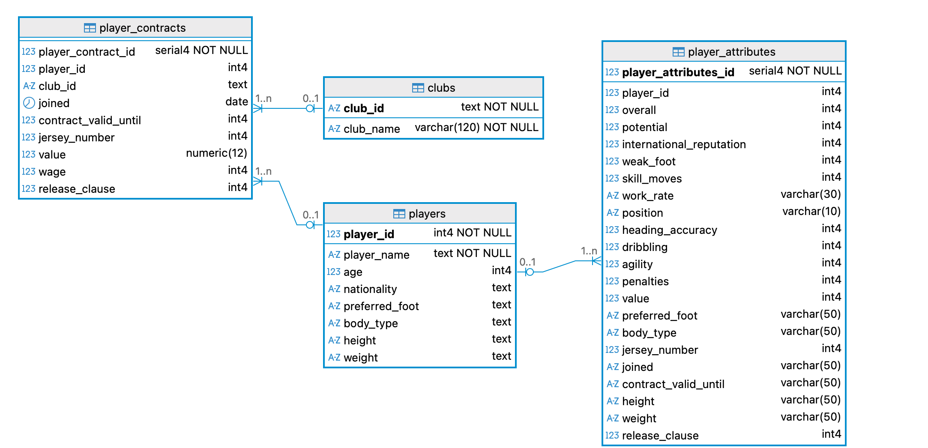
Implementation
Let’s see some examples considering our football database

Slide 7

UNION Operator
A
B
The UNION operator returns a union of two select statements
7

Slide 8
Syntax
SELECT column_list FROM table1
UNION
SELECT column_list FROM table2;
8

Slide 9
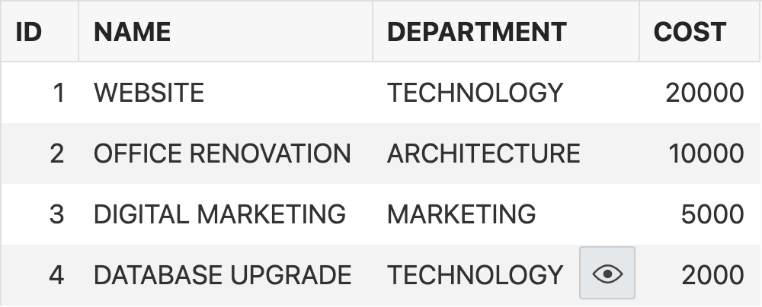
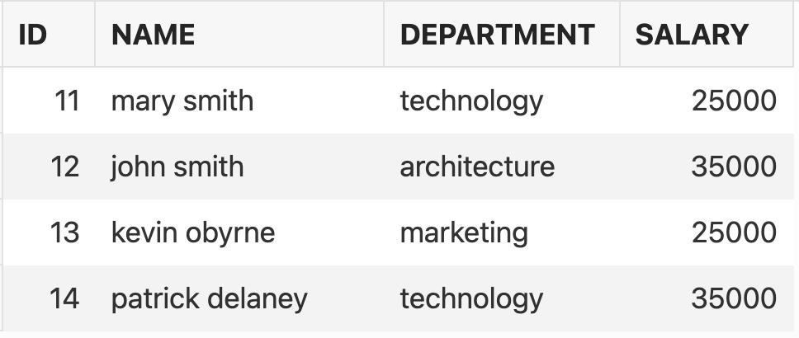
Using the UNION Operator
Consider the following tables. They have the same column department, but they are not connected.
Project
Employees
9

Slide 10
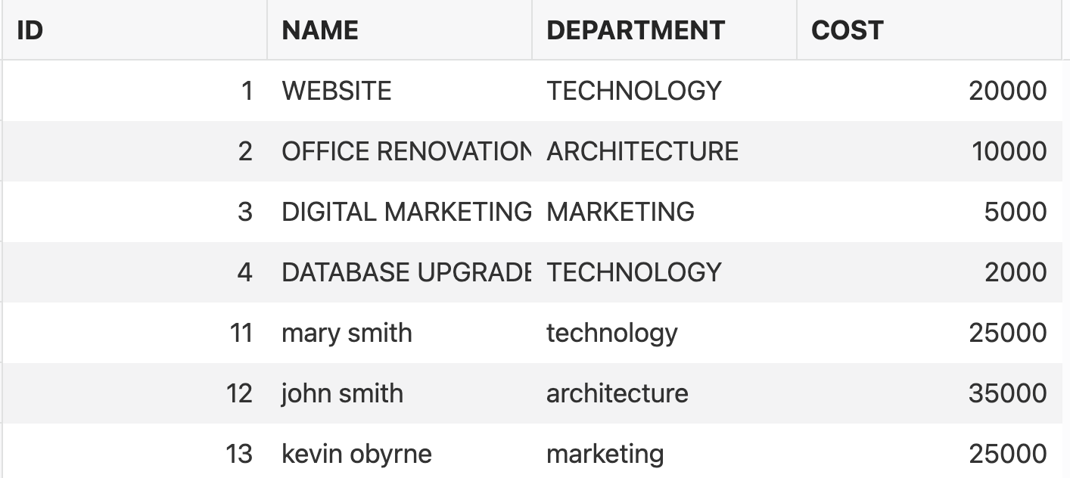
Using the UNION Operator
SELECT department FROM project
UNION
SELECT department FROM employee;
10

Slide 11
Using the UNION Operator
Every SELECT statement within a UNION must have the same number of columns
Having columns with the same data types across different SELECT statements within a UNION is also mandatory.
PostgreSQL can convert data types, but not always. Situations where one attribute is numeric and the other is int, for example, are allowed. But text and int won’t work.
Also, if you want the results to be ordered, you must use ORDER BY. Otherwise, PostgreSQL will display in whatever order is cheaper to the system.
11

Slide 12
Example using the Football schema
--Check the data types
SELECT DISTINCT pg_typeof(player_id) FROM players;
SELECT DISTINCT pg_typeof(club_id) FROM clubs;
--Will result in an error as data types are different
SELECT player_id, 'players' --we manually create another column with the name of the table
FROM players
UNION
SELECT club_id, 'clubs'
FROM clubs;
--Casting to make it work
SELECT player_id::text, 'players'
FROM players
UNION
SELECT club_id, 'clubs'
FROM clubs;
12

Slide 13
Using ORDER BY
--We can order by the first attribute selected
SELECT player_id::text, 'players’ “Source table”
FROM players
UNION
SELECT club_id, 'clubs’ “Source table”
FROM clubs ORDER BY player_id;
--If we try to order by the second attribute, we get an error as it no longer exists -- it was merged with the first one
SELECT player_id::text, 'players’ “Source table”
FROM players
UNION
SELECT club_id, 'clubs’ “Source table”
FROM clubs ORDER BY club_id;
This example shows that ordering by player_id works, but by club_id doesn’t as club_id was already merged to player_id when we ORDER BY.
However, we can use ORDER BY 2 instead – no errors and ordinal ordering is more efficient.
13

Slide 14
UNION ALL
UNION ALL will output data from both tables, including possible duplicates. In the schema we are using, both tables player_attributes and player_contracts have the attributes jersey_number. Let’s check the duplicates:
SELECT jersey_number, 'player_attributes' "Source table"
FROM player_attributes
UNION ALL
SELECT jersey_number, 'player_contracts' "Source table"
FROM player_contracts ORDER BY 1;
14

Slide 15
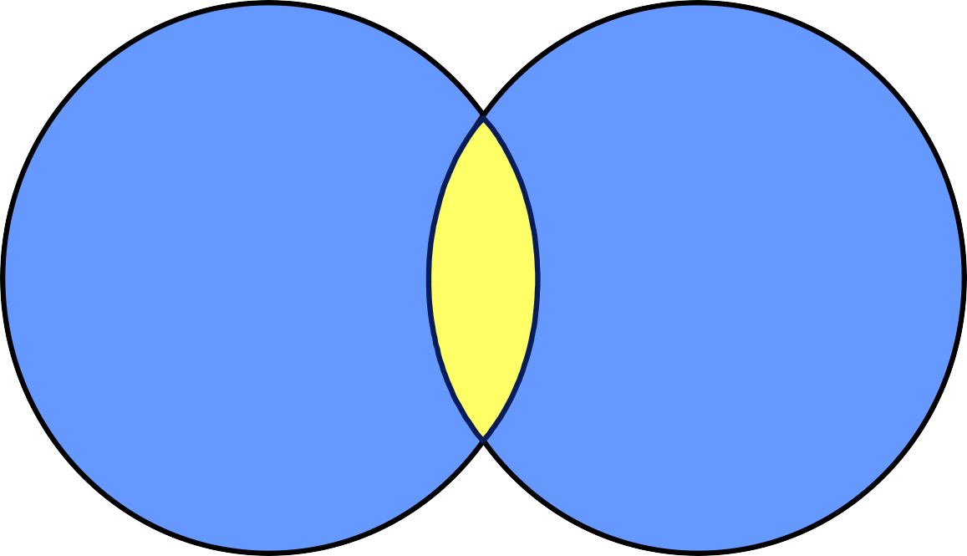
INTERSECT Operator
A
B
The INTERSECT operator returns rows that have common values to both queries.
15

Slide 16
Using the INTERSECT Operator
Every SELECT statement within INTERSECT must have the same number of columns
The columns should also have the same data types
The columns in every SELECT statement must also be in the same order
16

Slide 17
Using the INTERSECT Operator
SELECT column_list FROM table1
INTERSECT
SELECT column_list FROM table2;
17

Slide 18
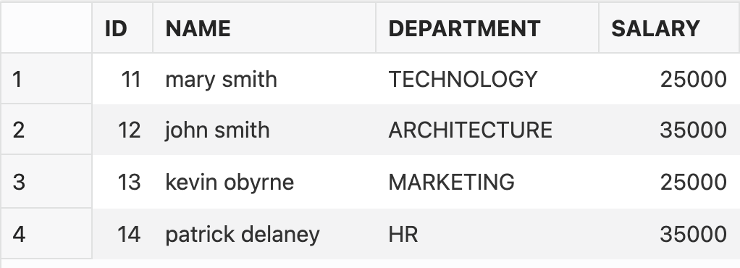
Using the INTERSECT Operator
Project
Employees
Suppose the employee Patrick Delaney changed to the HR department. Now, the employees table has a department that the project table does not have.
18

Slide 19
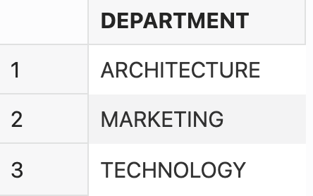
Using the INTERSECT Operator
SELECT department FROM project
INTERSECT
SELECT department FROM employee;
19

Slide 20
Using the INTERSECT Operator
The intersect will show the unique values shared by player_id in both tables.
In this case, we won’t be able to know the source table as only one value is shown.
SELECT player_id
FROM player_contracts
INTERSECT ALL
SELECT player_id
FROM player_attributes;
20

Slide 21

EXCEPT Operator
A
B
The EXCEPT operator returns rows in the first query that are not present in the second query.
21

Slide 22
Using the EXCEPT operator
Every SELECT statement within EXCEPT must have the same number of columns
The columns must also have the same data types
The columns in every SELECT statement must also be in the same order
22

Slide 23
Using the EXCEPT operator
Project
Employees
If we want to select the department attribute from the table Project MINUS the department attribute from the table Employees, what result would we get?
23

Slide 24
Using the EXCEPT operator
SELECT department FROM employee
EXCEPT
SELECT department FROM project;
24

Slide 25
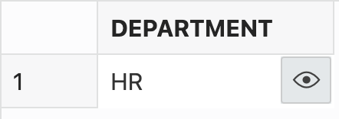
Using the EXCEPT operator
SELECT department FROM employee
EXCEPT
SELECT department FROM project;
25

Slide 26
Using the EXCEPT operator
--EXCEPT: Players that have data on attributes but no contract
SELECT player_id
FROM players
EXCEPT
SELECT player_id
FROM player_contracts;
--We can confirm the number using count in a join
SELECT COUNT(*)
FROM players
LEFT JOIN player_contracts USING (player_id)
WHERE player_contracts.player_id IS NULL;
26

Slide 27
UNION, INTERSECT and EXCEPT
Treat the tables as sets and are the usual set operators of union, intersection, and difference
They all combine the results from two select statements
The results of the two selects must have the same columns and data types
27

Slide 28
Joins x Set Operations
In certain scenarios, joins can be more efficient, particularly when working with large datasets.
Joins offer more customisation in specifying how tables should be combined based on specific criteria.
Use Joins when you need data from different tables based on their relationships and want a more complex, context-rich result set.
Use Set Operations when you want to combine results from tables that are not connected.
28

Slide 29


